Slide 1
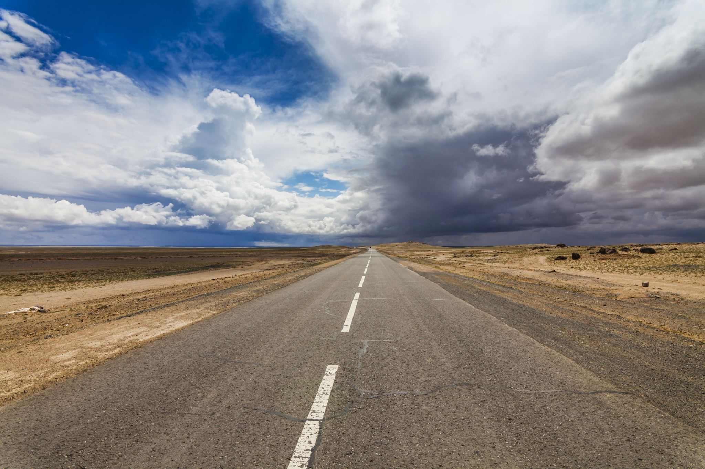
Analysis of Dallas Street Service Requests
ADTA 5240 Final Project

Slide 2
TEAM INDICATORS
Tejamanikanta Gudla
Sai Preethi Jiddigam
Ramya Sree Muppaneni
Rudheer Kumar Bolla
Ankita Talwadkar

Slide 3
Introduction
Residents use the 311 system, a dedicated non-emergency contact, to seek information and city services. This system primarily addresses local issues like road damages, disturbances, and vandalism, ensuring a seamless flow of communication between the community and municipal authorities. The data derived from this system is crucial for understanding community needs, evaluating the effectiveness of government responses, and planning urban development, considering the nature and geographic distribution of reported incidents.

Slide 4









Flow of Project
Generation/Collection of Data
Data Processing
Problem Statement
Storage of the Data
Data Analysis
Data Visualization
Interpretation of the data
Hive & Spark
Conclusion

Slide 5
Problem Statement
This dataset is valuable for analyzing trends in municipal service needs, assessing the efficiency of city response to public requests, and aiding in urban planning and resource allocation based on the types and locations of the issues reported.
Service Request Type
Latitude & Longitude
Method Received Description
Status and Dates
By creating queries and Visualization.

Slide 6

Generation/Collection of Data
Data is collected from dallasopendata.com is about road and transportation improvement works in Dallas area. Attributes involved in are Service request type, Service request number, Address, Latitude, Longitude and dates of created, updated and closed of 2020 to 2021 created service request are available in the dataset. It has 10968 rows and 17 columns.
https://www.dallasopendata.com/Services/311-Service-Requests-for-Fiscal-Year-2020-2021-Str/s3gf-a952

Slide 7
Data Processing
As part of the data processing process, unprocessed data is first translated into a more understandable format, such as graphs, papers, or other forms, giving it structure and meaning that can be comprehended by both computers and employees inside an organization.
We will first check the data set for duplicate or missing values using python and pandas libraries.
Here we used Open refine for cleaning data and sliced Latitude and Longitude into two separate columns.
Our dataset remains the same, demonstrating that it is free of null or duplicate values. After processing null values to Unknown and 0 for numeric values.

Slide 8
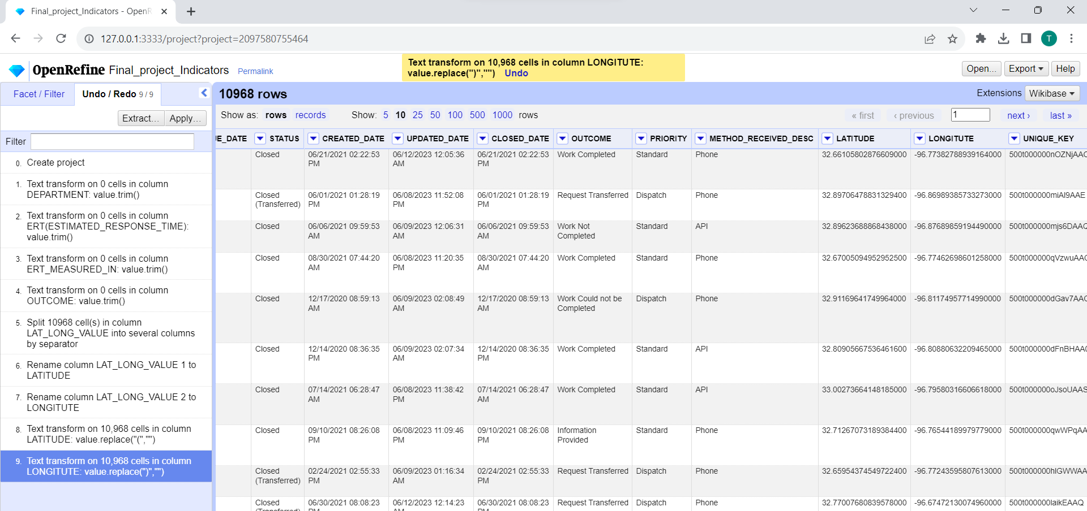


Slide 9
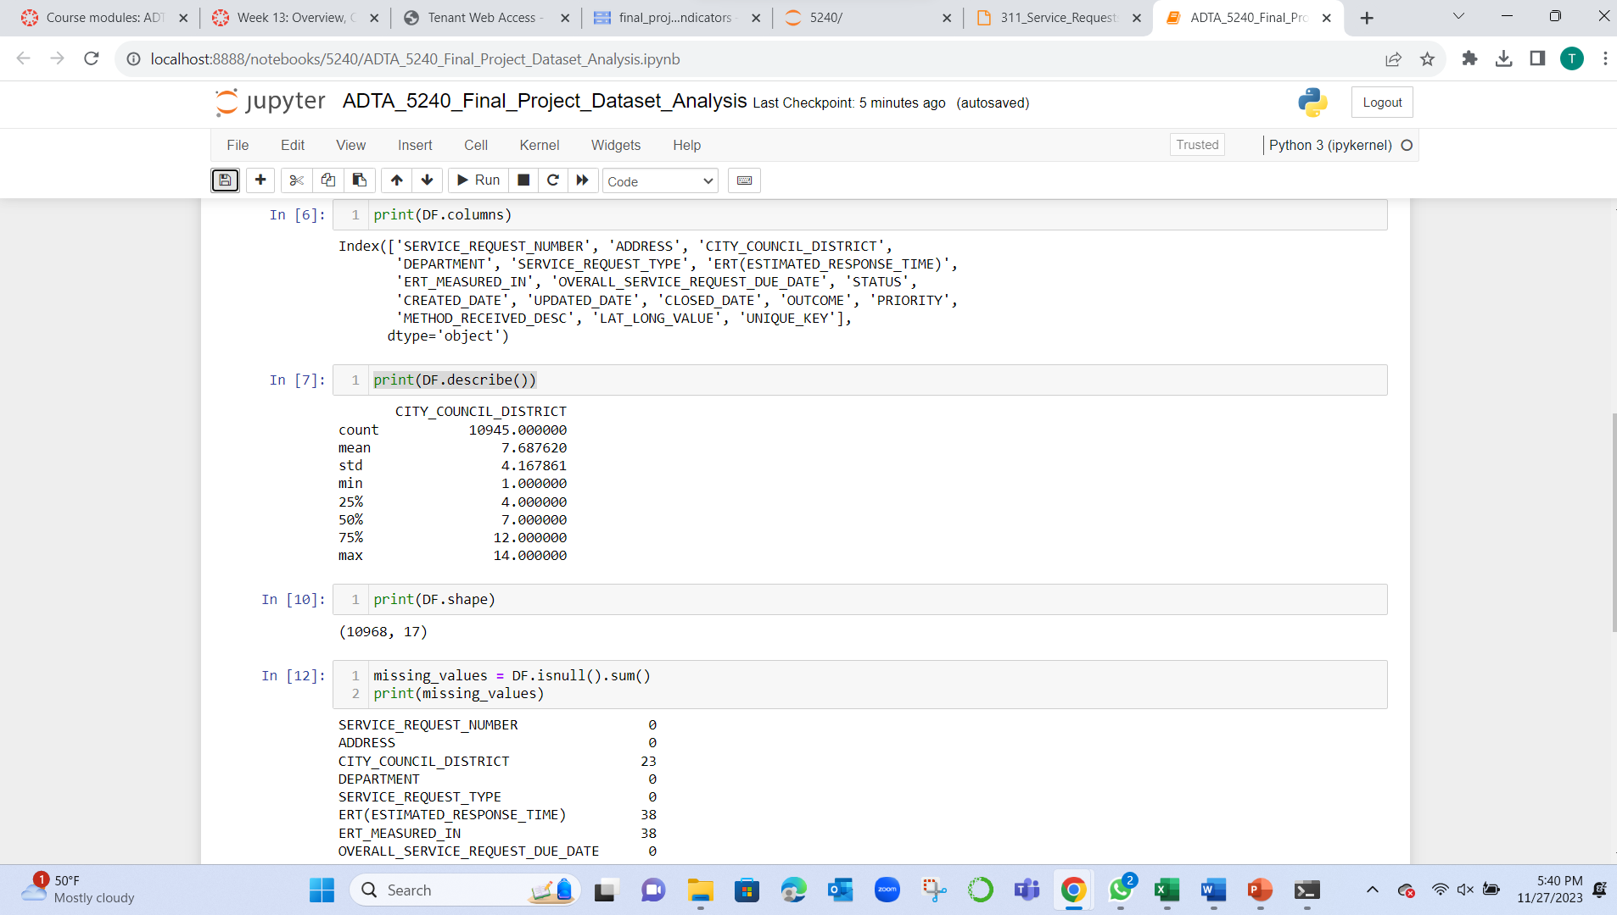

This Photo by Unknown Author is licensed under CC BY-NC

Slide 10
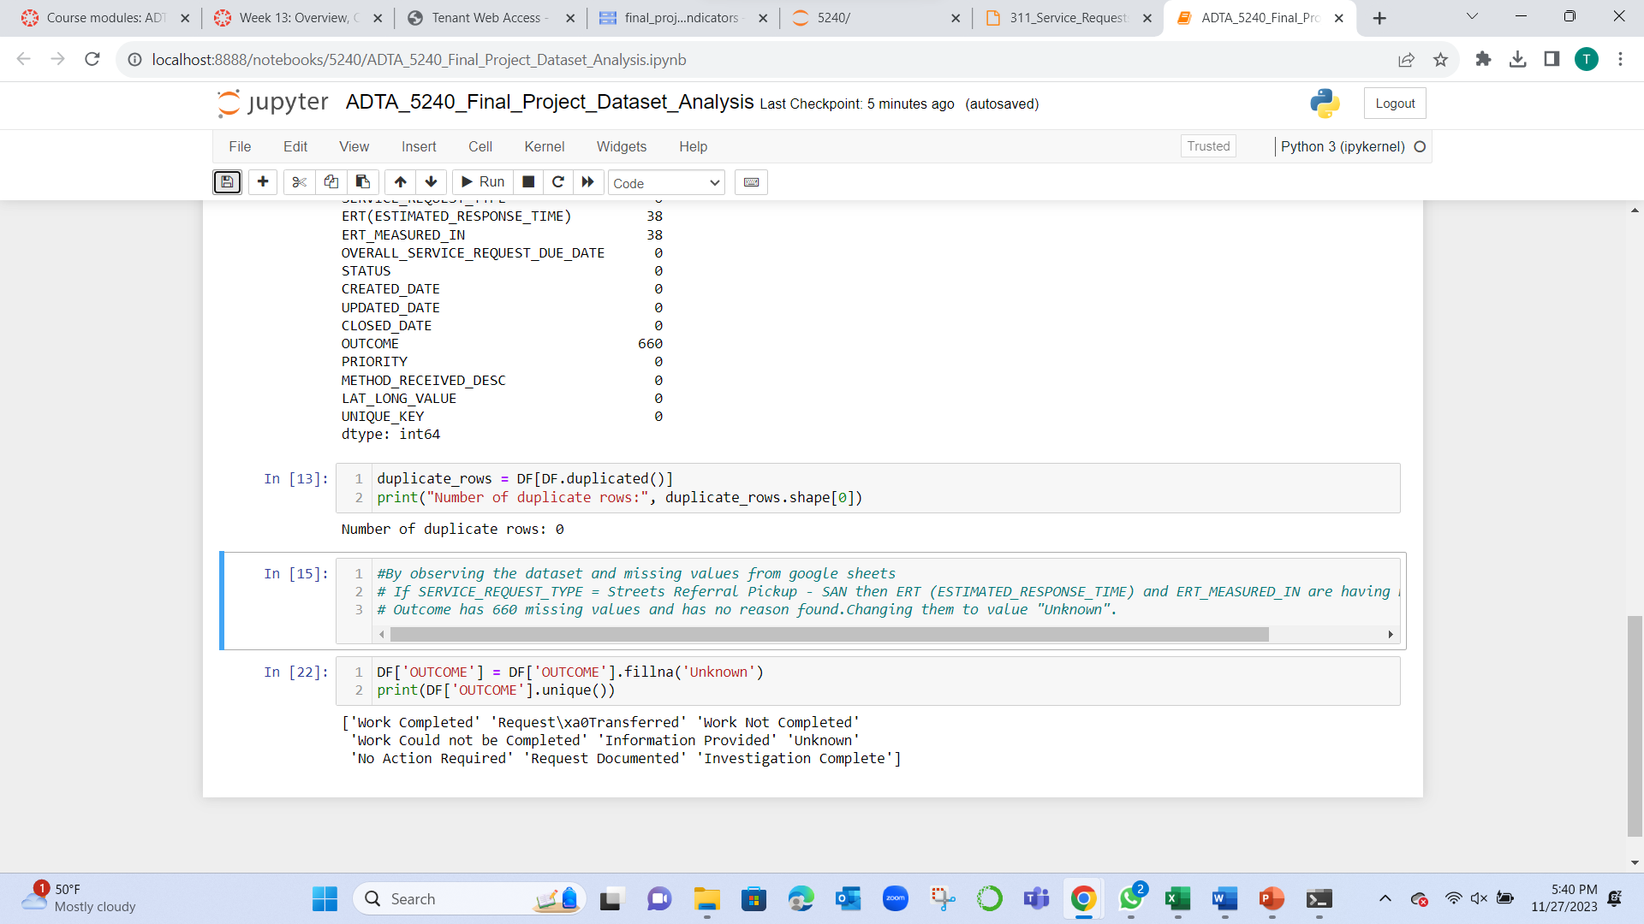
This Photo by Unknown Author is licensed under CC BY-NC

Slide 11
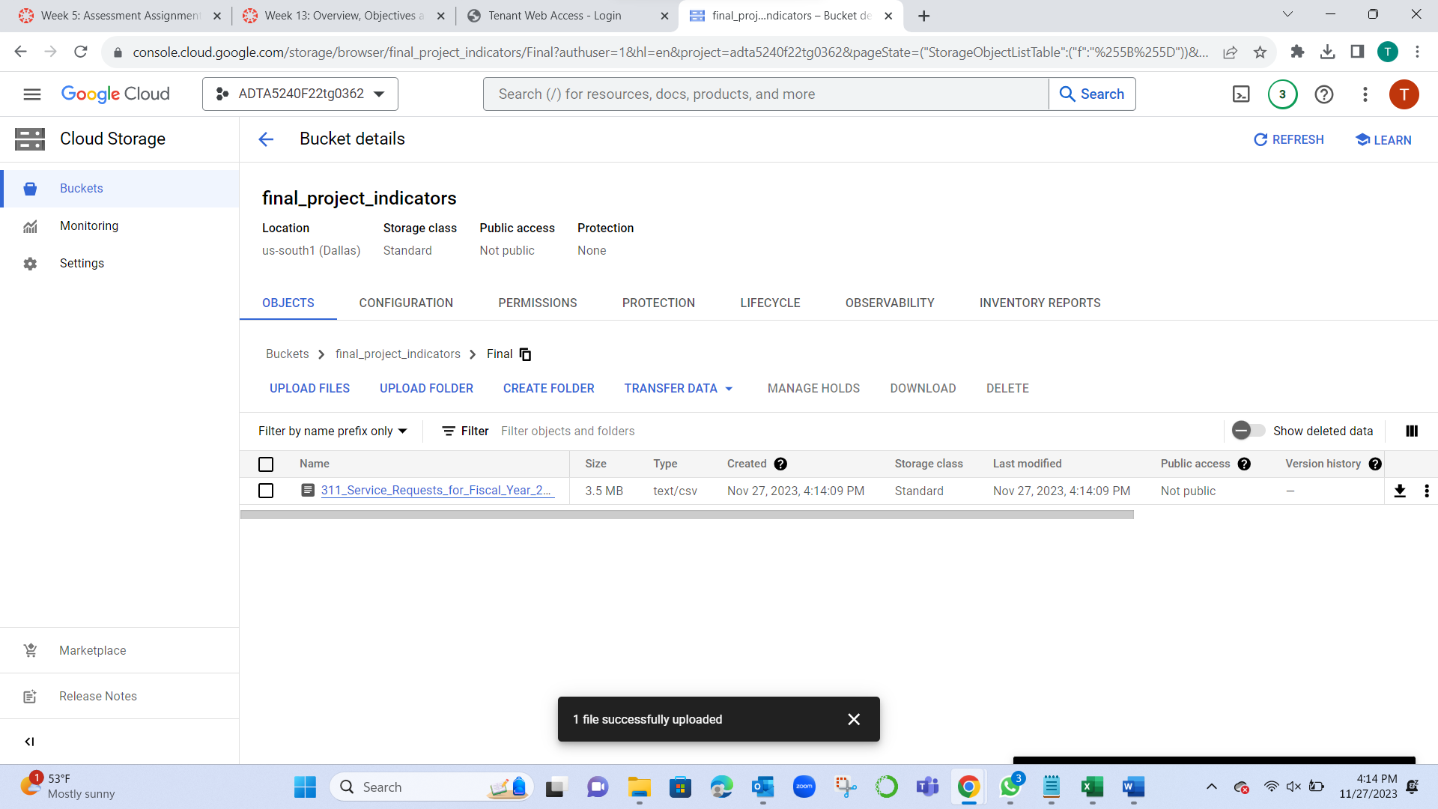
Storage of the Data
We have created a bucket and inserted dataset into the folder

Slide 12
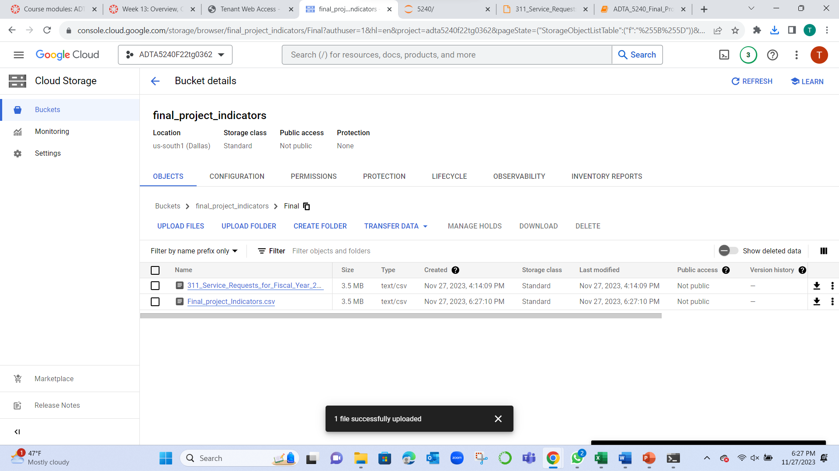

Slide 13
Data Analysis & Visualization
Data analysis has various steps. Let’s dive into one by one
Queries
Visualization

Slide 14
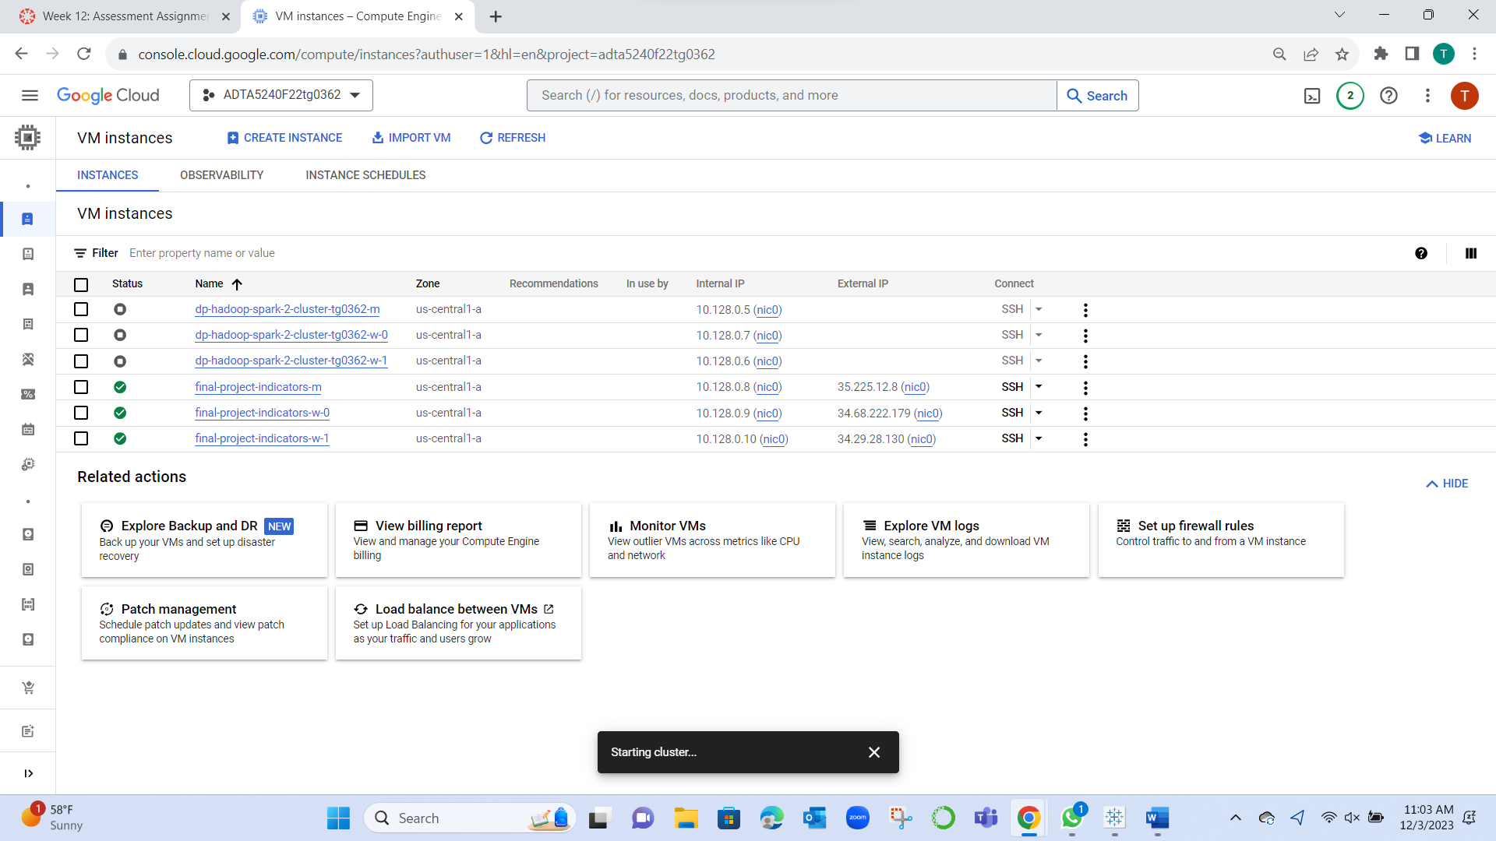
Clusters

Slide 15
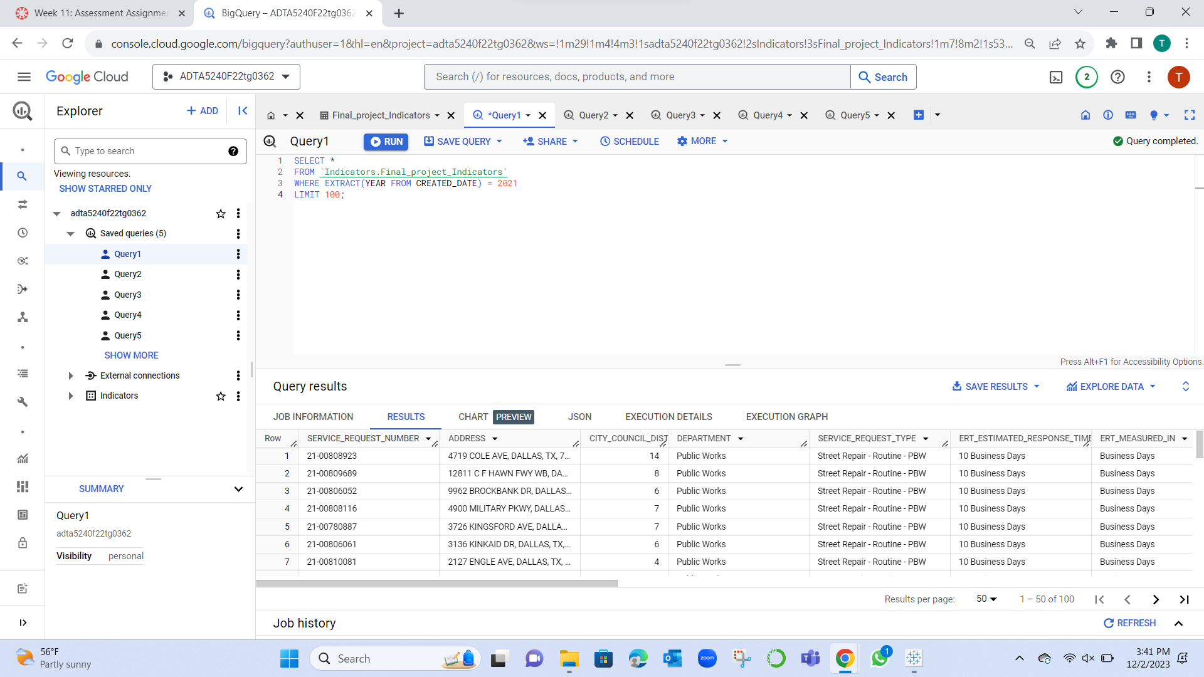
Query 1
SELECT * FROM `Indicators.Final_project_Indicators`
WHERE EXTRACT(YEAR FROM CREATED_DATE) = 2021 LIMIT 100;
It will result in data of first 100 records where created date is 2021.

Slide 16
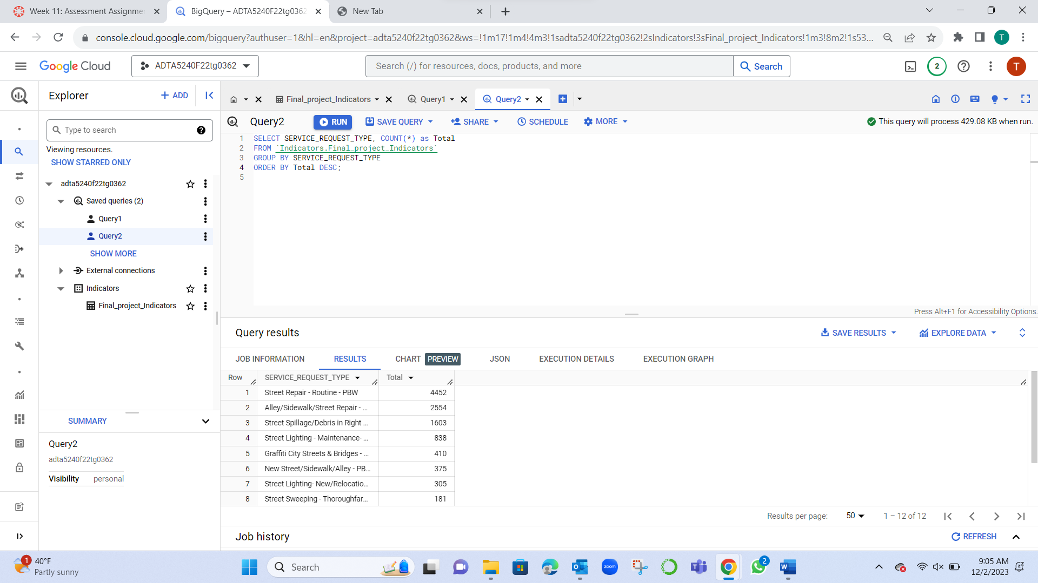
Query 2
SELECT SERVICE_REQUEST_TYPE, COUNT(*) as Total
FROM `Indicators.Final_project_Indicators`
GROUP BY SERVICE_REQUEST_TYPE ORDER BY Total DESC;
It will result in data Service request types and their respective count in decreasing order.

Slide 17
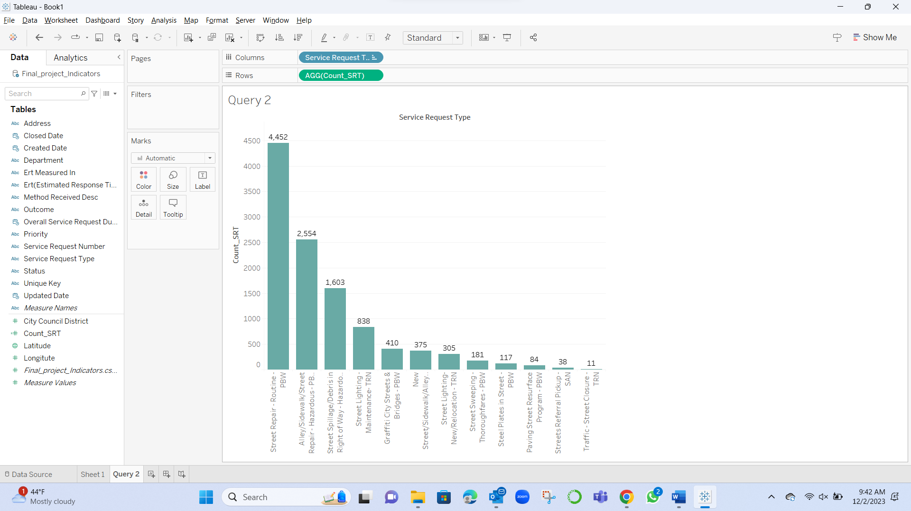
Visualization of query 2

Slide 18
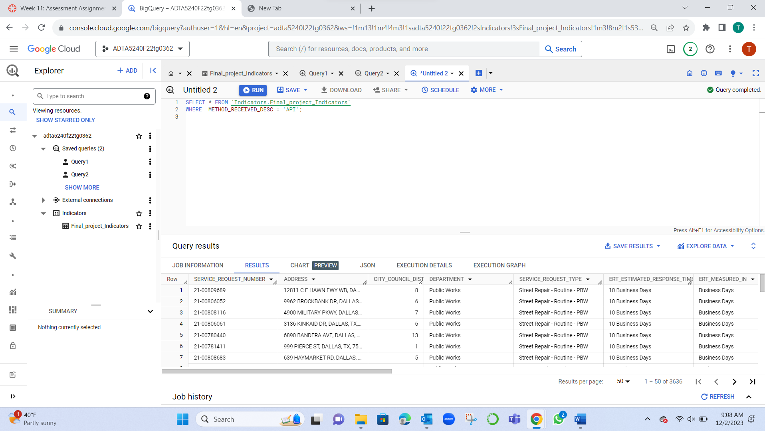
Query 3
SELECT * FROM `Indicators.Final_project_Indicators`
WHERE METHOD_RECEIVED_DESC = 'API';
It will result in data where Method received description is ‘API’.

Slide 19
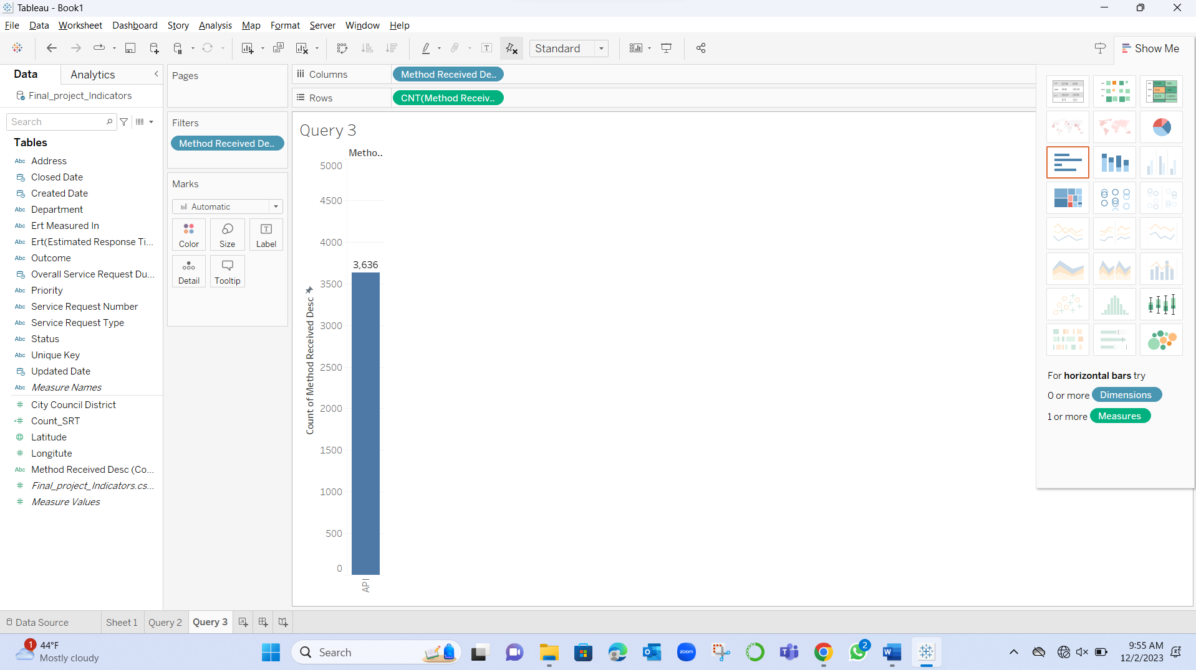
Visualization of Query 3

Slide 20
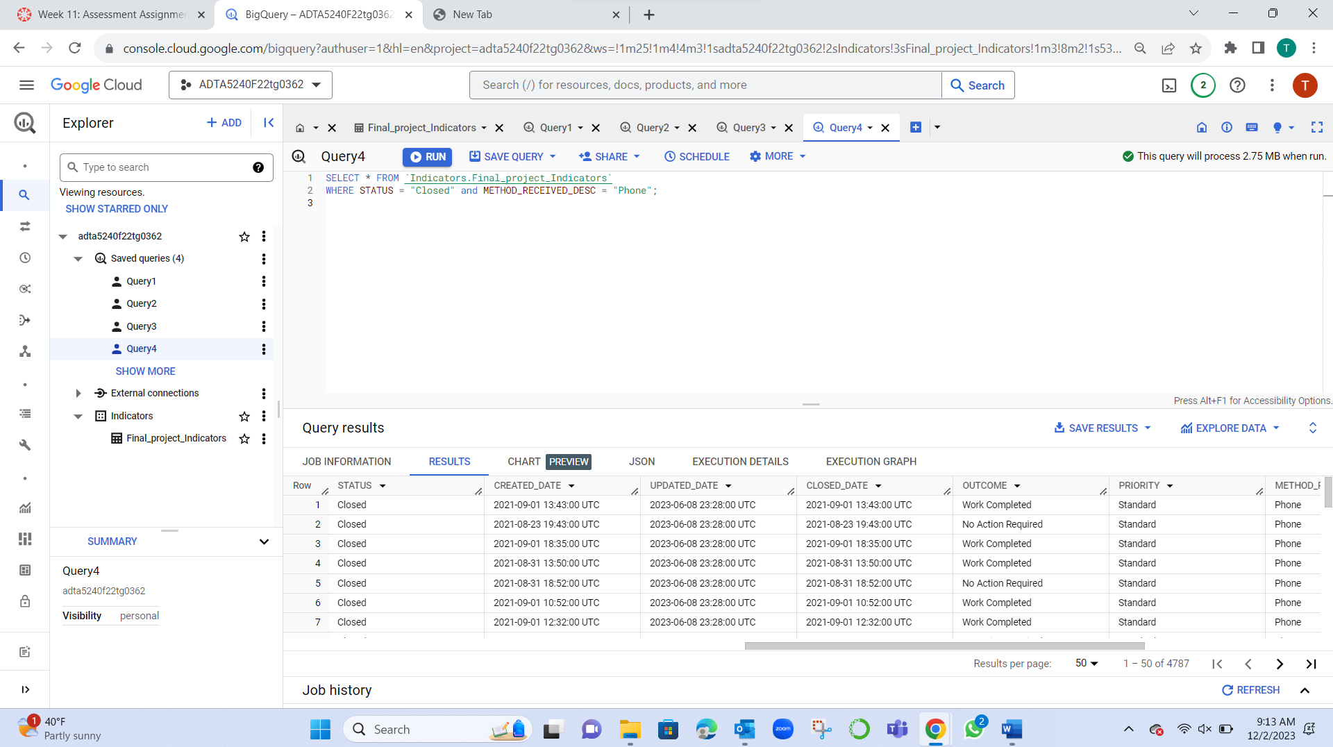
Query 4
SELECT * FROM `Indicators.Final_project_Indicators`
WHERE STATUS = "Closed" and METHOD_RECEIVED_DESC = "Phone";
It will result in data where it shows status is ‘closed’ and method received description is from ‘phone’.

Slide 21
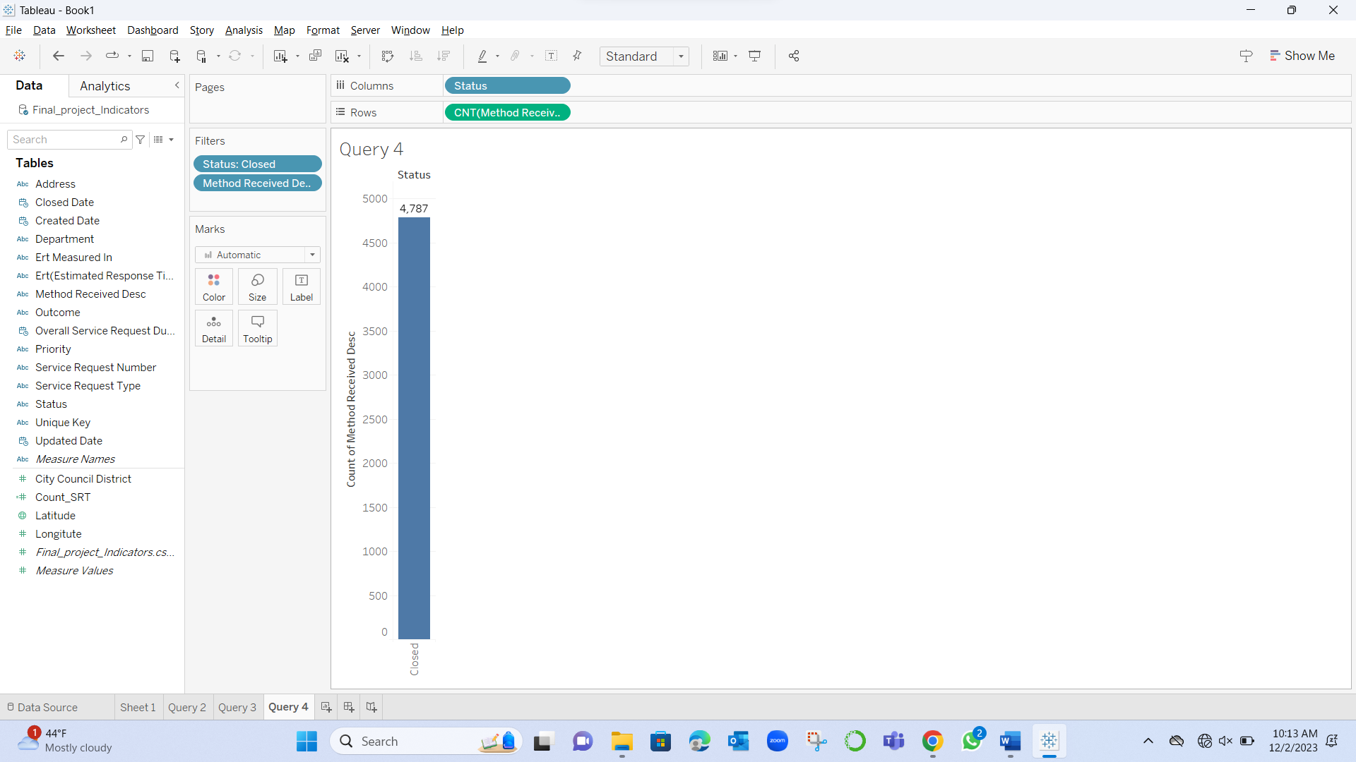
Visualization of Query 4

Slide 22
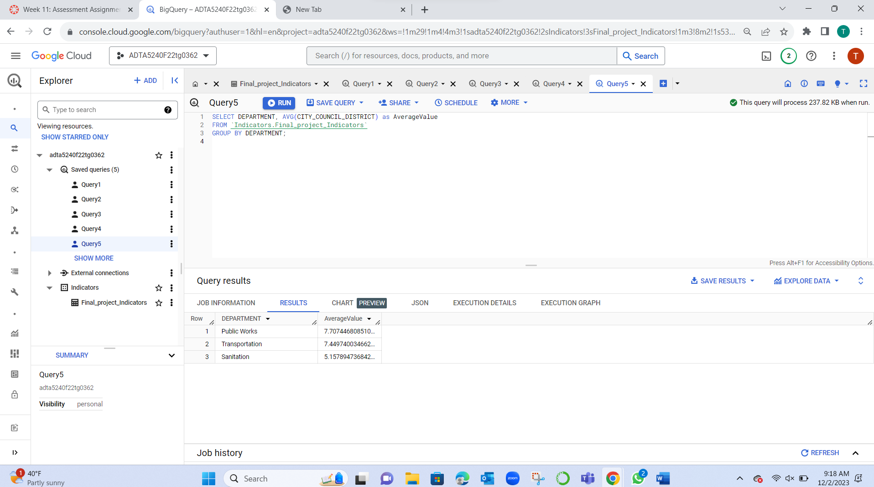
Query 5
SELECT DEPARTMENT, AVG(CITY_COUNCIL_DISTRICT) as AverageValue
FROM `Indicators.Final_project_Indicators`
GROUP BY DEPARTMENT;
It will result in data of average value of .

Slide 23
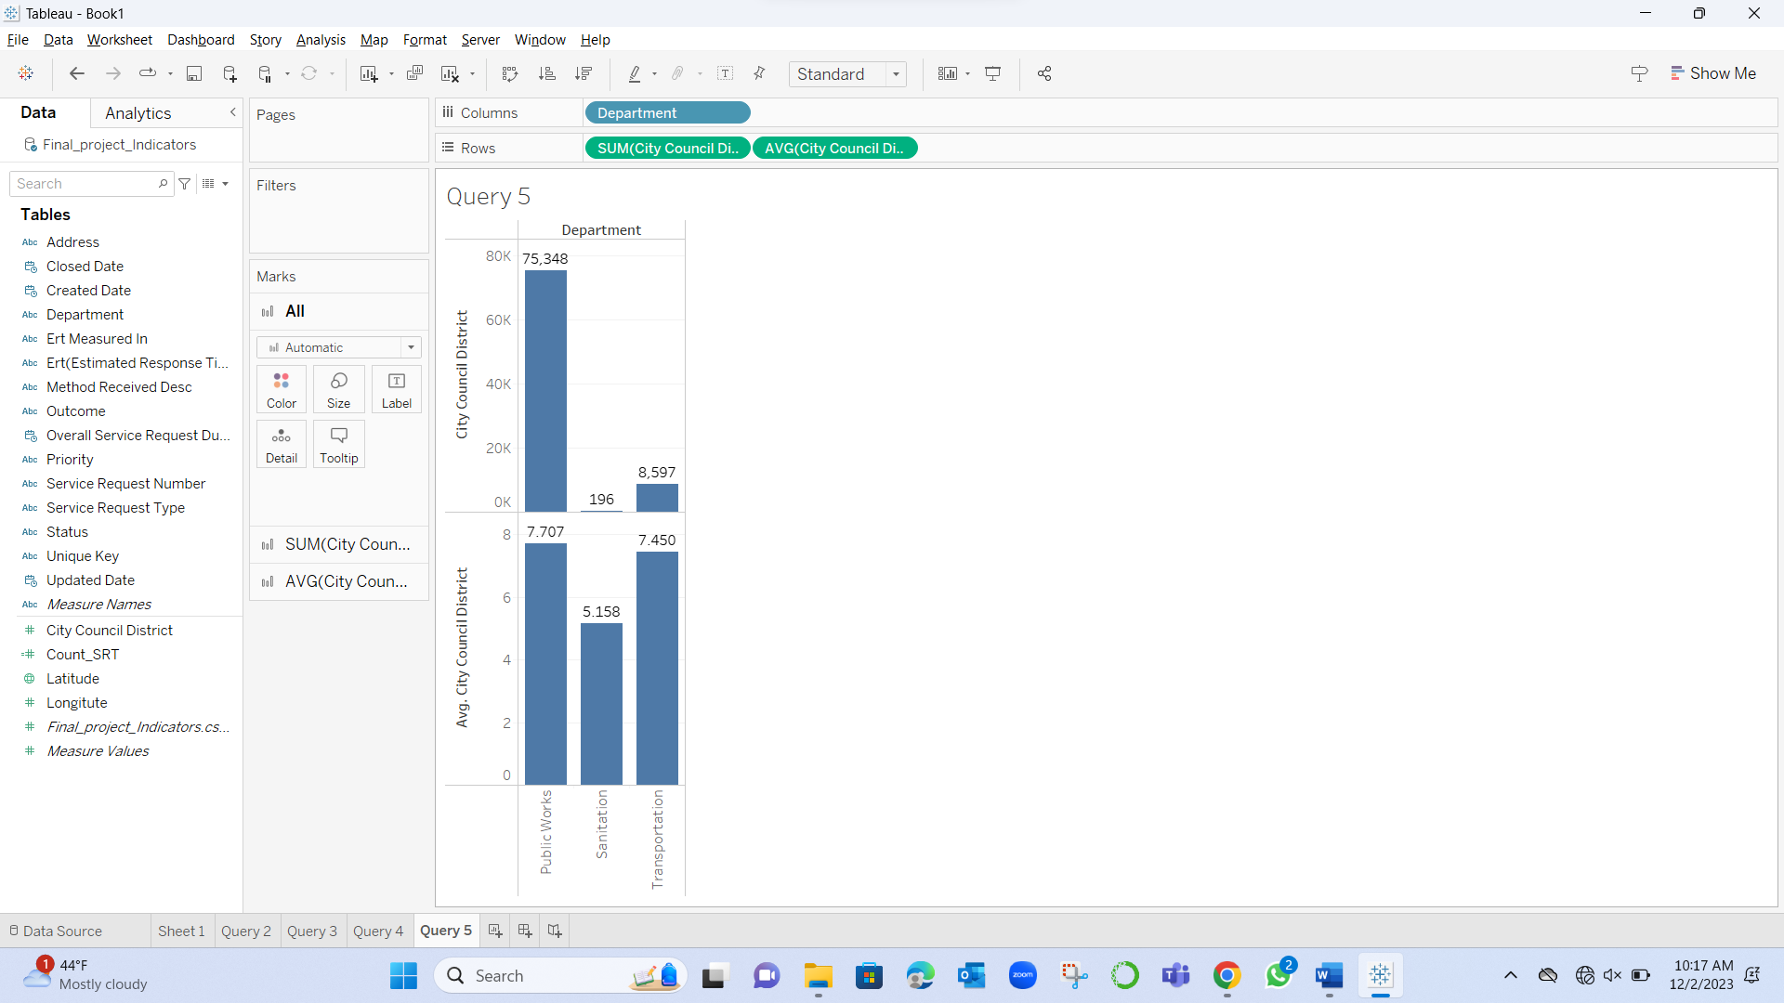
Visualization of Query 5

Slide 24
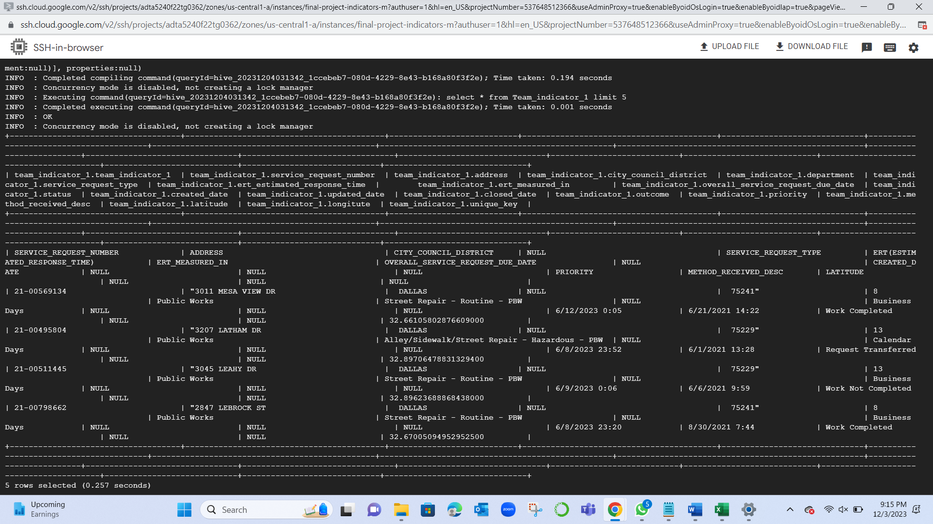

This Photo by Unknown Author is licensed under CC BY-ND

Slide 25
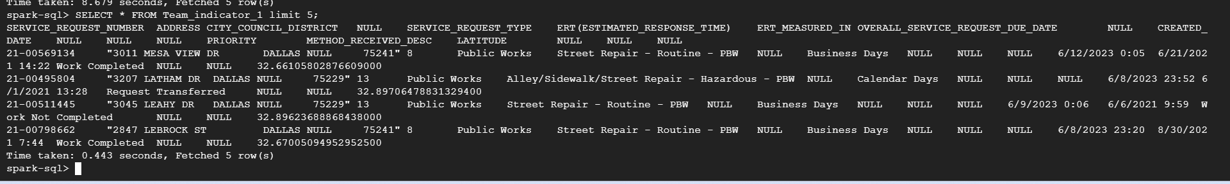


Slide 26
Conclusion
The "311 Service Requests for Fiscal Year 2020 - 2021 Street" dataset captures a broad range of non-emergency street issues reported in Dallas, reflecting resident-city interactions. It records details like service identifiers, locations, types, and council districts, tracking each request from inception to closure. This data aids in assessing city service performance and informs urban planning strategies. The project's lifecycle spans Generation, Collection, Processing (using Open Refine), Storage (in GCP), Management (via Big Query and Hive), Analysis (with Pandas and PySpark), Visualization (through Tableau), and Interpretation, facilitating efficient resource allocation and illustrating Dallas's commitment to public service.

Slide 27
Thank you

